Slide 1
Analysis of A Novel Phishing
Detection Approach by Jain and Gupta [1]
Brenden Morton and Jesse Chehal
Notes:
Hi, we are Jesse Chehal and Brenden Morton. The topic for our final project is an analysis on the novel phishing detection approach proposed by authors Jain and Gupta.

Slide 2
What is our topic?
Detecting Phishing Sites
Using algorithmic strategy
From the users device
Protect users privacy/data
Checking browser based phishing attempts
Notes:
Our topic involves attempting to detect phishing sites from the users device. The attempt is to use an algorithmic solution to detect and figure out safe/unsafe sites. By, detecting phishing sites we can protect users privacy and data. There are many types of phishing such as mobile, emails, etc but we are focusing on web based attacks. Internet phishing has become an increasingly relevant cyber security issue as a result of the COVID19 pandemic and the subsequent work-from-home and school-from-home nature of the world. This has widened the pool of phishing targets for attackers. In 2016, Jain and Gupta published a phishing detection model which used a combination of an auto-updating whitelist and a novel hyperlink based phishing classification algorithm. Our goal for this project is to implement the proposed phishing detection model authored by Jain and Gupta [1] and assess the effectiveness of their model to see if after 5 years their model still holds up.

Slide 3
Why is it important?
Ever increasing amount of phishing attempts
Phishing attacks rose 700% just in February 2020.
Vulnerable data including credit card, bank and social security information
Protect vulnerable citizens that have lower awareness of attacks
By preparing with web based attacks, we can prepare for attacks when mobile applications continue to rise globally
Notes:
As time goes on, phishing attacks are becoming ever more common. As it becomes more common, it becomes ever more likely that casual users of the internet are at risk of being duped by these attacks. According to Shi on Barracuda Networks, phishing attacks rose 700% just in February 2020. Many types of data may be attacked including credit card, bank and social security information. Many older and less aware citizens may not be aware of these types of attacks so it is important to try to prevent them in the first place. As mobile use continues to grow worldwide, knowing how to prevent web based phishing attacks can help use know how to adapt to prevent mobile phishing attacks.

Slide 4
Introduction
Attackers create web pages identical to legitimate sites to trick users into inputting vulnerable information
Modifying hyperlinks to trick users
Prevention by analysis and characterization of these sites
We want to determine the effectiveness of such prevention
Notes:
The idea behind phishing for attackers to trick users by creating web pages identical to legitimate sites to gain vulnerable information. Most of the time, it involves changing the website code by changing hyperlinks which point to a domain or website that the phishing attacker is in control of. The goal would be to improve prevention of these attacks by using analysis and characterization of the sites to detect them on the user’s end of the connection. We also want to determine the effectiveness of such prevention in the current climate of internet usage. As mentioned earlier, this proposed phishing detection model was published in 2016. Given that a great deal of time has past, the internet has evolved a great deal. By implementing this algorithm now, we will not only determine the effectiveness of the author’s phishing detection model, but we will also see if phishing sites have evolved as well.

Slide 5
Paper’s Authors Implementation
Fast and higher accuracy than other implementations
Auto-updated whitelist and phishing identification algorithm
White list contains domain and IP from DNS query
Algorithm uses hyperlink extraction
Marks sites as either phishing or legitimate
Notes:
There have been other attempts at preventing phishing attacks but we believe this paper to be somewhat unique as it was faster and higher accuracy than other implementations. The author’s implementation including an auto-updated whitelist and phishing identification algorithm using hyperlink features. Each entry in the whitelist structure, simply contains the domain of the site and the IP resolved from the DNS query of the domain. The algorithm mostly relies on hyperlink extraction which is part of why its fast and accurate as it is rather simple.

Slide 6
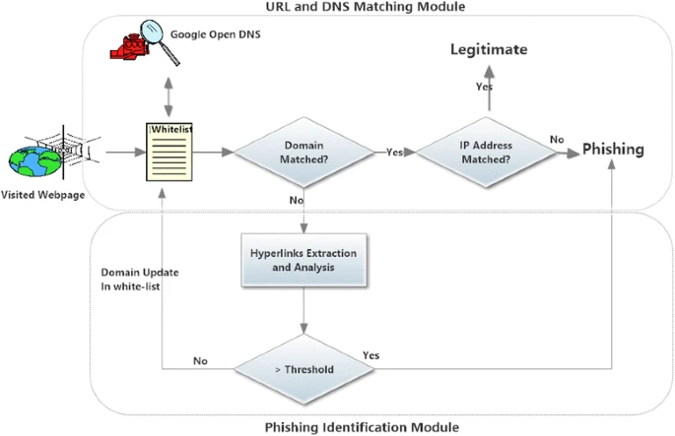
General Algorithm
Generalized flow chart
DNS search for domain and IP, if they both match its legitimate
Go through the Hyperlink Extraction and Analysis, if greater than threshold = phishing
Update the Whitelist
Notes:
This is the generalized flow chart created by the authors to detect phishing sites. Their model consists of two main modules: URL and DNS matching module and a phishing identification module. When a website is passed through this model, it first goes into the URL and DNS matching module. The first step is to query the whitelist to see if this site has already been determined as a legitimate non-phishing site. Looking at the flowchart, we see that Google Open DNS is used on the whitelist. This is a check to ensure that the DNS domain and ip address translation is not poisoned. If both domain and IP match and the DNS query results concur, then the website (domain and ip) is marked as legitimate. If the whitelist does not contain the domain and IP OR the domain does not match from the DNS query and the whitelist entry, then the site is sent to the phishing identification module for classification. Here, hyperlink features are extracted to determine if a site is phishing or not. If the Domain matches from the DNS query and the website is in the whitelist BUT the IP address from the DNS query does not match the IP address in the key-value pair from the whitelist, then the site is determined to have been poisoned on the DNS server and determined to be a phishing site.

Slide 7
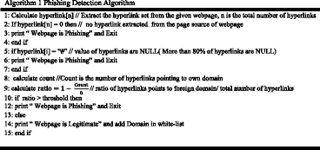
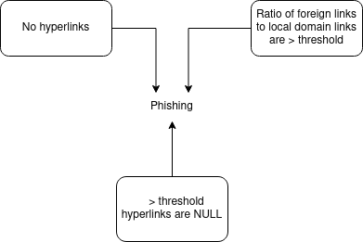
Phishing Detection Algorithm
Hyperlink Extraction and Analysis section from previous flow diagram
Extract hyperlinks from webpage
If no hyperlinks = phishing
Href = ‘#’ > 80% of hyperlinks = phishing
Calculate ratio = 1 - Count of foreign pointing hyperlinks/Total
If ratio > threshold = phishing
If website passes all these, it is likely legitimate and can be added to whitelist
Notes:
It is a rather simple phishing detection, which is part of the fast and high accuracy of this paper. It is the Hyperlink Extraction and Analysis section from previous flow diagram.First we calculate the hyperlinks, getting the total set of hyperlinks and total n number of hyperlinks. If no hyperlinks, phishing and break. If > 80% are null hyperlinks, phishing and break. We can calculate the ratio as 1-(Total number of hyperlinks pointing to foreign domain/total number of hyperlinks). If ratio is greater than threshold, it is determined to be phishing and break. If it passes all these conditions, it is likely legit and can be added to the whitelist. As stated, this is a quite simple algorithm working on solely the hyperlink feature set from the website under inspection. Extracting the hyperlink set is quite fast compared to the other phishing detection approaches, which include machine learning and blacklist based detection models. Machine learning models require long training time and use visual cues from the site for classification. Phishing detection approaches that use a black-list are often slow since sites need to be compared to the black-list. However, this is quite ineffective since new phishing sites can just change their hosting site, domain, etc. and the black-list approach will fail.

Slide 8
Our implementation
Instead of Java7 we used Python 3.8.10
Easier for scripting
Instead of built in browser extension, we used script for simplicity of replicating
We simulated internet activity with a list
PhishTank has a list of verified phishing sites
Notes:
For our implementation, we decided to use Python 3.8.10 instead of Java because we just wanted to create a script to run the set of phishing sites. The main reason for this was just that we preferred Python3 over Java and it was more efficient to write the program in Python. The author’s implemented it into a browser extension but we just used the script for simplicity sake. There is no issue with using a different programming language since the phishing detection model need not matter on the speed or efficiency of the programming language. Instead, the results of the model are of importance. Thus, any programming language could have been used for this implementation. Unlike the authors’ implementation, we simulated internet activity by sending a list of phishing and legitimate URLs into our implementation of the authors’ model. The authors used a different approach. The authors first gave their detection algorithm a list of determined phishing sites using Phishtank. In addition to that, they installed the chrome extension on computers in their graduate program’s laboratory. Different graduate students would then use these computers and the authors’ phishing detection algorithm was always running in the background. We chose to just simulate internet activity by generating a list of both phishing sites and valid sites. By running these sites into the implemented model, we could simulate a user or many users accessing different sites; both phishing and valid.

Slide 9
How we will test our implementation
Create list of phishing and valid sites
Input this list into the model
For-each threshold value seen in the paper’s results, run the model
Generate the results and compare to the authors’ results.
Notes:
To achieve a better comparison of our implementation results and the authors’ implementations results, we will try to match the exact test procedure that the authors’ performed. From analyzing the results in the paper and referencing the discussion, we were able to create this procedure. First, we use the same phishing site database called PhishTank for a dataset of verified phishing sites. Then, we scraped the most popular sites from multiple sources to have a list of verified legitimate websites. With a proper dataset of websites, we then input all of the data into the model. The model will then run for a single threshold representing the percentage of foreign domain pointing links that would trigger a phishing classification for a given page’s hyperlink feature set. Then, based on the threshold values seen in the paper, we will run the model for each of these threshold values. After this, we are able to effectively compare our results with the authors’.

Slide 10
Final Results
Notes:
We will now discuss our results that we obtained from running our list of phishing and valid sites through our implementation of the authors’ model.

Slide 11
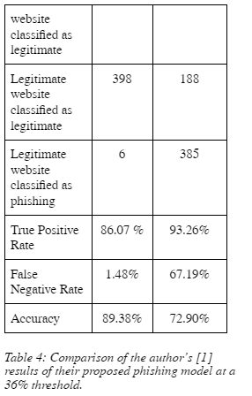
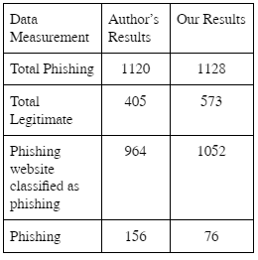
Results: 36% threshold
Notes:
The table above represents the data collected when using the 36% threshold value for the percentage of foreign domain pointing hyperlinks. Both images come from the same table but we split it to fit on the PowerPoint slide. As seen above in the table on the left, we have roughly the same size dataset so the results can be closely examined as similar implementational results. The data above suggests that the hyperlink extraction was very effective at detecting phishing sites. This can be seen in the in the True Positive Rate cell in the table on the right. Our results are showing a true positive rate of about 93% which is higher than the authors’ results of 86%. On the other hand, we see that our False Negative rate, or the rate at which legitimate websites are classified as phishing sites is astronomically larger than the results from the paper. We obtained a 67% false negative rate and the authors’ obtained a under 2% false negative rate. So, overall, this model is still highly accurate at classifying phishing sites as phishing but the data supports the model is highly inaccurate at correctly classifying legitimate sites. This could suggest that there has been little evolution in phishing site’s hyperlink set composition but an drastic increase in a legitimate website’s hyperlink composition. Because our sample set of legitimate sites consisted of the most popular sites on the internet, it is likely that these sites are owned by companies and or internetal corporations. Because of this, these companies may have different servers around the world or even around the country making domains and IP addresses having the possibility to differ. This makes the whitelist ineffective for legitimate sites for large companies or heavily trafficked sites. On the other hand, we see that phishing sites are highly accurate to classify with this model. The true positive rate from the results of both our implementation and the authors’ implementation to be very accurate. This can imply that phishing sites have not really changed all that often, at least in the phishing sites from our dataset.

Slide 12
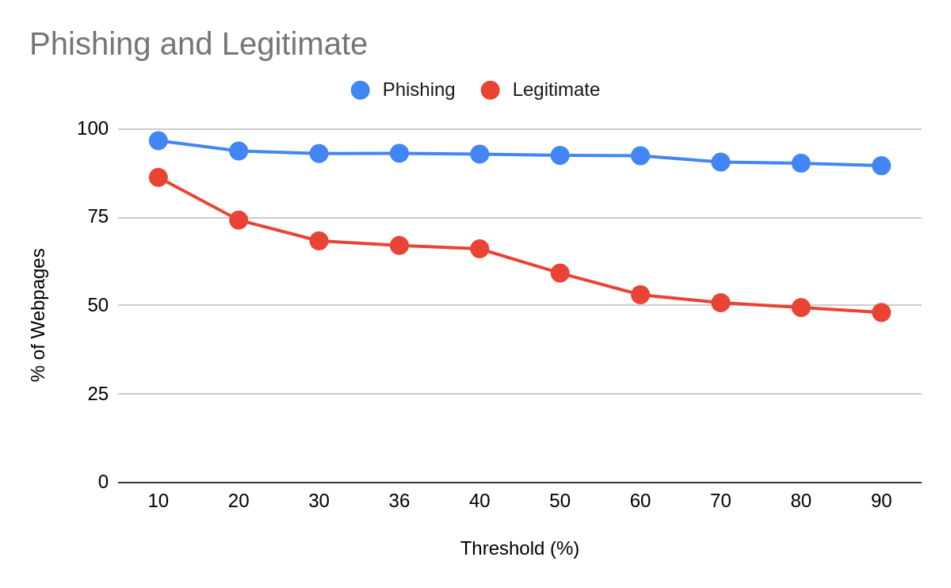
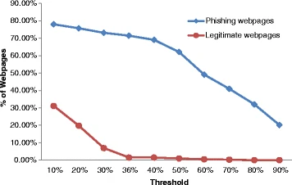
Final Results: Comparing thresholds
Notes:
In the graphs above, we are comparing the results on the percentage of phishing sites to legitimate sites for each threshold. The graph on the left is the results from our implementation and the graph on the right is from the authors’ implementation. As seen, the phishing sites are in blue in both graphs, and the legitimate sites are in red. Looking out our graph versus the paper’s, we see that our phishing site detection is almost constant around 90% as the threshold increases, whereas the paper shows an almost linear drop-off around the 40% threshold. The legitimate websites are somewhat comparable. Our results on the left somewhat correlate to the paper’s results excpet that our results are shifted up by about 50%. The results from here suggest that the hyperlink feature set mainly the threshold of foreign links to other domains is not as effective as it once was in 2016. Instead, there needs to be another feature to be analyzed since the model is over-classifying sites as phishing. It is too sensitive with the current features being analyzed.

Slide 13
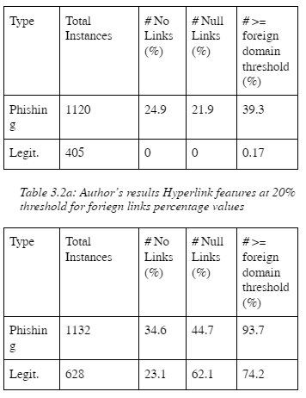
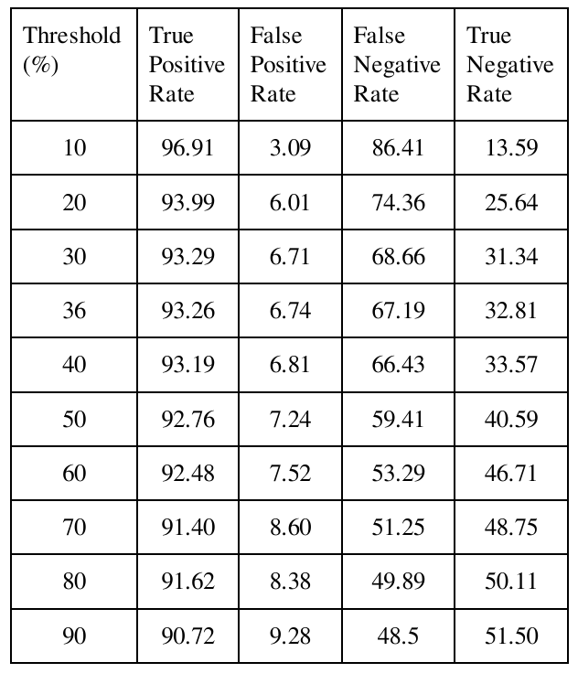
Final Results: Additional data collected
Notes:
Lastly, we will compare some additional data that we collected. The image on the left shows two tables. The table on the top shows the results from the authors for the 20% threshold value and the table below it shows our results for the same threshold. These tables show the data collected from the model run at 20% threshold value. More specifically, we are showing the hyperlink feature data that is used in the classification of a site as either phishing or legitimate. As discussed in both our paper and the authors’ paper, the three features that are analyzed are the number of hyperlinks on a web page, the number of null (#) links on a web page, and the number of foreign domain pointing links on a webpage. As seen in the top table, the table shows the results for both phishing and legitimate sites for each of these features. Looking at the authors’ results, we see that at a 20% threshold, about 25% of phishing sites have no hyperlinks and contain null links. And about 40% of phishing sites have more than 20% foreign domain links. On the other hand, legitimate sites analyzed at this 20% threshold are showing quite different results. 0% of legit sites have no links or null links. And only 0.17% of legit sites have foreign domain links. Looking at our results, we see a huge shift. For phishing sites at 20%, we see that the percentages are higher for all features. And for legitimate sites we are seeing a massive difference. We believe that the legitimate sites that the author’s used were mainly based on academic or websites based on the school/university they were running the chrome extension on. Our legitimate results were based off of the most popular websites. Based on their hyperlink set features in their phishing identification module, results can drastically vary depending on the nature of the site. More popular global sites are likely to have many foreign domain pointing links which coincides with our results. We obtained about 74.2% of legitimate sites being over the 20% threshold. The authors on the other hand are getting about 0.17% for the same data. This further follows our assumptions that the nature of the site greatly impacts these features and thus this model does not work that well with legitimate sites.
On the table on the right, we included a list of all of the classification rates for each threshold just as additional data to show. As seen, the true positive rate is pretty consistently above 90% along with a relatively consistent false positive rate as a result. But the false negative rate and subsequently the true negative rate vary a lot. The main reason is likely due to, as mentioned before, the dataset of legitimate sites that authors’ used.

Slide 14
Conclusion
Overall, good foundational phishing detection model
Performed well after 5 years since publication of model
Detects phishing sites very well
Around 90% at correctly detection phishing sites
Does poor job marking legitimate sites as phishing
More than 60% classifying legitimate sites as phishing
Algorithm favors smaller sites (university sites) not large global popular sites
Notes:
We found that the overall model has a good foundation idea. It ends up detecting phishing sites very well marking a large percentage. But it does a poor job marking legitimate sites as phishing. The model needs to be updated to reduce the amount of legitimate being marked while also keeping phishing detection at a high level. If the model is implemented into a browser it would need to be updated over time to keep it from misclassifying sites as sites change structure over time. This has a lot of promise as being a detecting system but without constant updates, it can easily become outdated for legitimate sites.

Slide 15
References
[1] Jain, A.K., Gupta, B.B. A novel approach to protect against phishing attacks at client side using auto-updated white-list. EURASIP J. on Info. Security 2016, 9 (2016). https://doi.org/10.1186/s13635-016-0034-3
[2] Shi, F., 2020. Threat Spotlight: Coronavirus-Related Phishing. [online] Barracuda. Available at: <https://blog.barracuda.com/2020/03/26/threat-spotlight-coronavirus-related-phishing/> [Accessed 10 April 2022].
[3] Phishtank.org. 2022. PhishTank | Join the fight against phishing. [online] Available at: <https://phishtank.org/> [Accessed 10 April 2022].
[4] Moz. 2022. Top 500 Most Popular Websites. [online] Available at: <https://moz.com/top500> [Accessed 10 April 2022].

Slide 16
References
[5] Sooter, B., 2016. GitHub - bensooter/URLchecker: Test URL Filtering against a list of sites.. [online] GitHub. Available at: <https://github.com/bensooter/URLchecker> [Accessed 16 April 2022].
[6] Huss, N., 2022. How Many Websites Are There in the World? (2022) - Siteefy. [online] Siteefy. Available at: <https://siteefy.com/how-many-websites-are-there/> [Accessed 18 April 2022].
[7] Morton, B. and Chehal, J., 2022. GitHub - brend3n/CAP6135-Phishing. [online] GitHub. Available at: <https://github.com/brend3n/CAP6135-Phishing> [Accessed 22 April 2022].

